Slide 1

Logistic Regression

Slide 2
Logistic Regression Steps
01
Data Analysis
Univariate analysis & Bivariate Analysis
02
Data Transformation
Missing value analysis – Mean & Mode imputation
03
Model Building
Data split – Train & Test
04
Model Building
Regression equation, Validation & Prediction
Notes:
Content Slide: This is usually the most frequently used slide in every presentation.
Use this slide for Text heavy slides. Text can only be used in bullet points
Title Heading – font size 30, Arial Heading
Slide Content – Should not reduce beyond Arial body font 16
If you need to use sub bullets please use the indent buttons located next to the bullets buttons in the tool bar and this will automatically provide you with the second, third, fourth & fifth level bullet styles and font sizes
Please note you can also press the tab key to create the different levels of bulleted content

Slide 3

Model Building Approach
1. Business Problem
2. Exploratory data analysis
Understanding the problem statement
Predict the price of the car
Higher /Lower priced
Data cleaning
Descriptive statistics
4. Validation
3. Modeling Development & Validation
Accuracy & Model interpretation
Logistic regression using R Studio
Model iterations to find best influential variables
Finalize the model with the highest prediction accuracy
Notes:
Agenda slide
Heading – Agenda - Font size 30, Arial Headings
Agenda points to be in Arial Body (font size 28)
Please restrict this slide with just 5 agenda points.
If you have more than 5 points on the agenda slide please add another slide.
If you have only 3 then you can use just one slide and delete the other 2 points.

Slide 4
Modeling Building Approach
01
Understand the structure of the data
Identify Missing values – Mean & removal of duplicates & Outlier treatment
04
02
Univariate Analysis/Frequency Analysis
Model Building – Response variable coding
05
03
Bivariate Analysis – to find out relationship between independent variable & dependent variable
Model Building – Data split in 70:30 test & train (Simple Random sample method)
06

Slide 5

Data Analysis
We have 462 observations for our model
The data contains the customer attributes of car like make, fuel type, body type, height, weight, length etc.
Data contains 1 Dependent variable and 32 Independent variables
Missing Values- 138 Missing values are found in 5 independent variables but out of which 128 is found in normalized losses hence we are dropping this independent variable
Data was split into training and testing as follows
Training (70%) | Testing (30%)
324 | 139

Slide 6
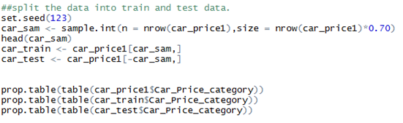
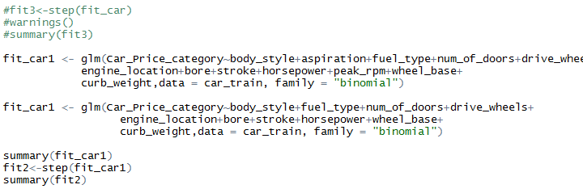
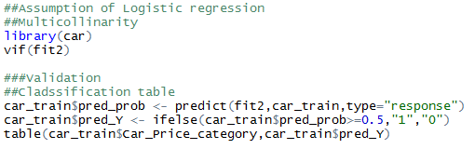
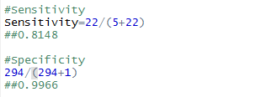
Model Building
We are using Logistic Regression Technique to predict the price category (binary) as the response variable is a category

Slide 7

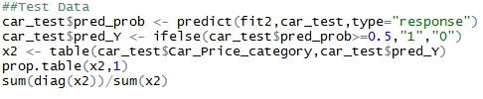
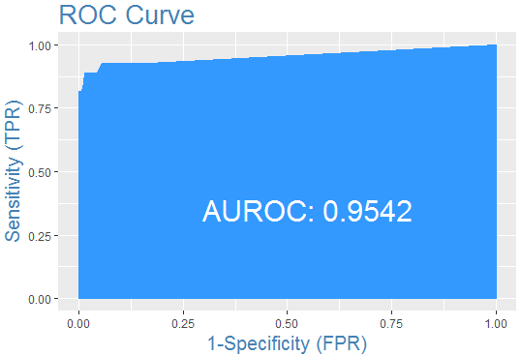
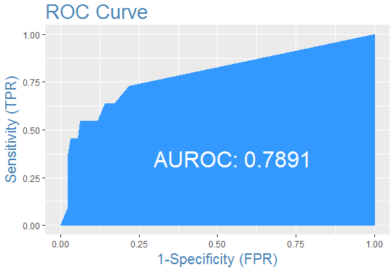
Model Results

Slide 8
Thank you

